Slide 1


Biomarker Core
ADNI Steering Committee
Boston, MA 4/24/2017
Leslie M Shaw
John Q Trojanowski

Slide 2
New biomarkers in NIA/ADNI/RARC-approved studies
Biomarker | Fluid | # | ADNI study | Investigator
NFL & Tau diag/prognosis | Plasma | 3,000+ | ADNIGO/2 BL + longitudinal | HZetterberg;NMattsson;Kblennow; Sweden
sTREM2 | CSF | 1007 | ADNI1/GO/2 BL + longitudinal – shared samples | MSuares-Calvert,MEwers; DZNE, Germany
sTREM2 levels & AD; IA | CSF | 1007 | ADNI1/GO/2 BL + longitudinal | Cruchaga; Wash U
Metabolic networks | Serum | 905 | Studies in ADNIGO/2 BL samples | RKaddoura-Daouk; Duke Univ,
Aβ1-42/1-40;ELISA | plasma | 764 | ADNI 1, GO, 2 in BL & longitudinal | ISherriff; Araclon Biotech
Metabolic networks | serum | 833 | Studies in ADNI1 BL samples; data uploaded | RKaddoura-Daouk; Duke Univ,
SNAP25 & neurogranin | CSF | 612 | Longitudinal samples | AFagan; Wash University
T-& Phos-α-SYN; IA | CSF | 567 | Longitudinal samples, to be uploaded | JZhang; University of Wash
Vilip 1; YKL-40; IA | CSF | 612 | Longitudinal samples, publication planned | AFagan; Wash University
Tau; IA | plasma | 595 | BL ADNI1; publication | KBlennow; Sahlgrenska UHosp
Neurogranin; NFL; IA | CSF | 416 | BL ADNI1; multiple publications | KBlennow; Sahlgrenska UHosp
Proteome/ MRM/MSMS | CSF | 306 | BL ADNI1; 221 proteins;publication;another planned | ADNI PPSB/FNIH; LHonigsberg
Proteome/RBM | plasma | 1,065 | BL & yr1; multiple publications | HSoares;Pfizer/PPSB/FNIH
Proteome/RBM | CSF | 317 | BL ADNI1; multiple publications | WPotter,etal/PPSB/FNIH
BACE & sAPP | CSF | 402 | BL ADNI1; recent publication | MSavage;merck/PPSB/FNIH
α-Synuclein;xMAP | CSF | 390 | BL ADNI1; several publications | JZhang; University of Wash

Slide 3
Alzheimer’s Disease (AD) And Related Dementias (ADRD) Often Show Comorbid Multi-Proteinopathies
DISEASE | LESIONS | COMPONENTS
Alzheimer’s Disease (AD) The most common multi-proteinopathy | SPs (100%) NFTs (100%) LBs (-50%) TDP-43 (-50%) | Aβ Tau Alpha-synuclein TDP-43
Frontotemporal Degeneration (FTD) | Inclusions | Tau (FTLD-Tau), TDP-43 (FTLD-TDP), FTLD-FUS
Amyotrophic Lateral Sclerosis (ALS) | Inclusions | TDP-43, FUS, Tau, SOD1
Parkinson’s Disease (PD) -/+ Dementia (PDD) & Dementia With Lewy Bodies (DLB) | LBs, SPs, NFTs | Alpha-synuclein, Aβ, Tau
Multiple System Atrophy (MSA) | GCIs | Alpha-Synuclein
Prion Diseases | SPs | Prions, Tau, Aβ, Alpha-synuclein
Trinucleotide repeat diseases | Inclusions | Expanded polyglumatine repeats

Slide 4
PART/Ageing AD
Incidental Alpha-synuclein (Syn) And TDP-43 (TDP) Pathologies Are Rare In PART/NA, But Very Common In AD Such That Only 35% Of AD Patients In Our CNDR Brain Bank Have Pure Plaque And Tangle only AD.
+tdp 2%
+tdp+syn 2%

Slide 5

TDP-43: Potential Use
Useful for diagnosis of AD and related dementias (ADRD)
Useful treatment selection for ADRD
Useful for formulating prognoses for ADRD
Useful for monitoring disease progression for ADRD
Useful for monitoring disease modifying therapies when available for ADRD
Acknowledgements: Many thanks to Linda K. Kwong, Yan Xu, Dawn M. Riddle and Virginia M.-Y. Lee for all their efforts on TDP-43 antibody production and ELISA development and to John Robinson, Maria Corrada and Claudia Kawas for their efforts on the comorbid pathology studies. These studies were made possible through grants from NIA/NINDS and the Koller Family Foundation as well as the support of the Families of our patients.

Slide 6
Why automation of CSF biomarkers?
Eliminate as many manual steps as possible
Promote best possible precision & accuracy
  Within-lab
  Between-labs
    using common samples, eg AlzAssn QC program
    Same study population and pre-analytical protocol, eg, treatment trials
    Different study populations and pre-analytical protocols, eg, ADNI, BioFINDER
Improved lot-to-lot performance
Enable IVD test approval clinical laboratory test
Can provide both accurate and precise data
Use in treatment trials, especially international where local laboratory is essential(eg, China).

Slide 7
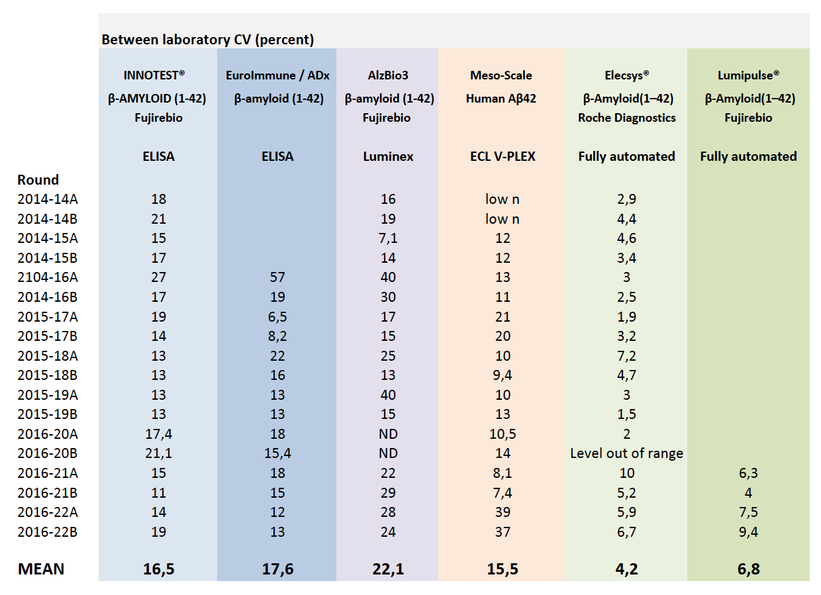
Between-labs performance: Alz Association QC program
KBlennow

Slide 8
ADNI3 Aims for Biomarker Core
Aim 2: Provide highly standardized Aβ₁₋₄₂, t-tau and p-tau₁₈₁ measurements on all ADNI subject CSF samples using the Roche automated immunoassay platform(Cobas e601) and immunoassay reagents. In addition provide immunoassay-independent measurements of Aβ species (Aβ₁₋₄₂, Aβ₁₋₄₀ and Aβ₁₋₃₈) using a validated reference 2D-UPLC/tandem mass spectrometry method in baseline and longitudinal CSF samples. Continue collaboration with other investigators to achieve harmonization of these measurements across centers and different platforms in support of their use in clinical trials.
Change: from manual RUO immunoassay to fully automated immunoassay platform for ADNI 3:
Due diligence: started Q4, 2014, in consultation with ADNI Exec Comm & NIA & PPSB/BBWG/DDWG.
Selection: in consultation with ADNI PPSB/BBWG/DDWG, chaired by Johan Luthman.
Roche Elecsys: validation for Aβ₁₋₄₂ in CSF completed.
External QC: Participation in the AlzAssn CSF QC program for Aβ₁₋₄₂
Validation of t-tau and p-tau₁₈₁: completed FALL, 2016
Analyses of all ADNI CSFs: late FALL, 2016-early WINTER, 2017
Continued collaboration: with Kaj Blennow & AlzAssn and IFCC CSF WGs to produce certified reference CSF pools with assigned reference Aβ₁₋₄₂ concentration values, measured with reference 2D-UPLC/tandem mass spectrometry, to provide certified reference materials for validation of Aβ₁₋₄₂ calibrators--promoting harmonization across assay platforms.
Review & participate in: studies of pre-analytical factors for CSF collection.

Slide 9
Analysis of 2401 ADNI1/GO/2 CSF samples
2401 ADNI pristine CSFs, collected from 9/7/2005 to 7/25/2016 were analyzed in 36 analytical runs at UPenn from 11-17-2016 to 1-20-2017:
  402 ADNI1 BASELINE; 819 ADNIGO/2 BASELINE
  ADNI1: 112 HC, 192 MCI, 98 AD
  ADNIGO/2: 160 HC, 96 SMC, 277 EMCI, 154 LMCI, 132 AD

Slide 10
Analyses of ADNI1/GO/2 CSF Aβ₁₋₄₂, t-tau, p-tau₁₈₁ using the Roche Elecsys fully automated immunoassay platform
Rationale for moving from RUO to full automation
Validation of Aβ₁₋₄₂ for precision, accuracy, and clinical performance
General statistics for Aβ₁₋₄₂, t-tau, p-tau₁₈₁, t-tau/Aβ₁₋₄₂, p-tau₁₈₁/Aβ₁₋₄₂ in the ADNI1/GO/2 CSF samples
Histogram distributions for Aβ₁₋₄₂, t-tau/Aβ₁₋₄₂, p-tau₁₈₁
Distributions based on FBP amyloid-β PET + or –
Cutpoint determinations
Collaborative study with BioFINDER
Concordance with FBP amyloid-β PET
Prediction of cognitive decline(CDRsob)
Summary

Slide 11
Method validation studies at UPenn: Roche Elecsys immunoassay
CSF Aβ1-42:
  Analytical studies
    Short and long-term precision studies
    Linearity
    Comparison of Elecsys between UPenn and Roche
    Comparison with a reference mrm/mass spectrometry method
    Comparison with the RUO AlzBio3 immunoassay
    Two sets of non-ADNI CSF samples utilized(250 residual CSF from routine clinic patients; 129 CSFs from the UPenn ADRC)
  ROC analyses for AD vs HC in 129 CSFs from the UPenn ADRC(62 AD, 67 HC)

Slide 12
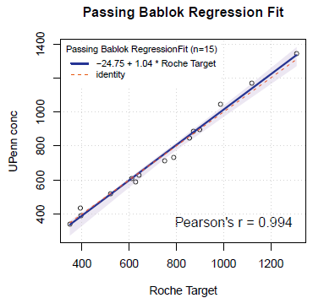
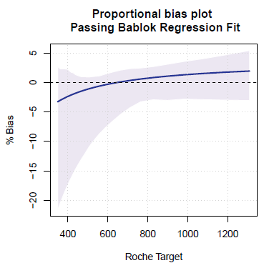
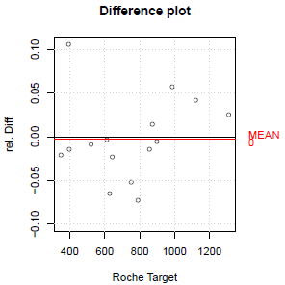
SUMMARY
UPENN/Roche comparison (both use Roche Elecsys,15 CSF pools): PB regression—Y = 1.04X - 24.8; Pearson‘s r = 0.994
Bias at cut-off <10%
Slope is within 1.0 ± 0.1
Elecsys, AlzBio3 and LC-MS Abeta(1-42) measurements were performed for 250 samples from data set A and 129 samples from data set B
Data set A and B were not pooled as AlzBio3 measurements differed between the two sample sets
Correlation between
  Elecsys and AlzBio3: Spearman‘s rho 0.86(A)/0.82(B); some non-linearity
  Elecsys and LC-MS: Spearman‘s rho 0.95(A)/0.96(B); Linear relationship details in following ppt.
  LC-MS and AlzBio3: Spearman‘s rho 0.87(A)/0.77(B); some non-linearity
ROC-AUC analysis within the data set B(AD vs HC): equivalent performance of all 3 methods
*Toronto 2016 AAIC meeting poster & included in an AAIC symposium talk.

Slide 14
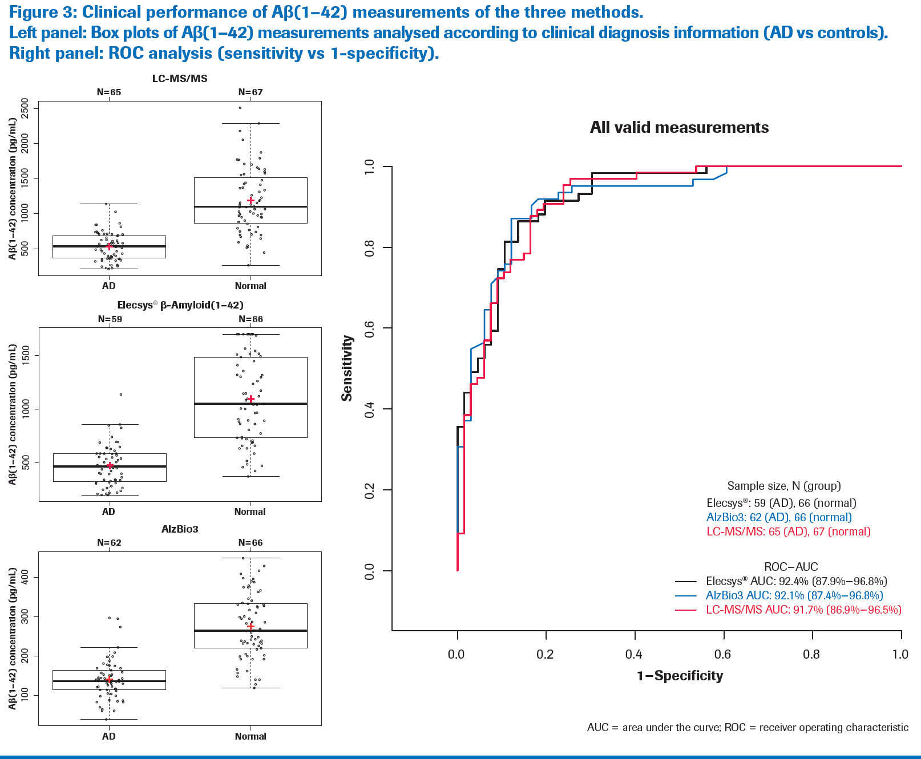

Slide 16
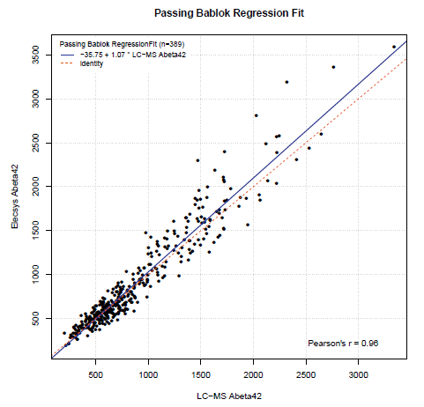
Roche Elecsys versus LC/MS for ADNI1 BASELINE CSF Aβ₁₋₄₂
Confirms finding from UPenn Method Comparison study: linear relationship and approximately 1:1

Slide 17
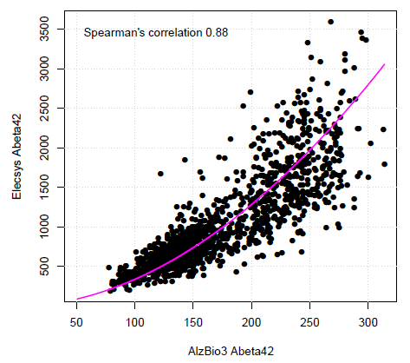
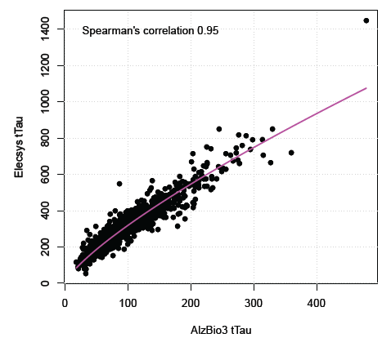
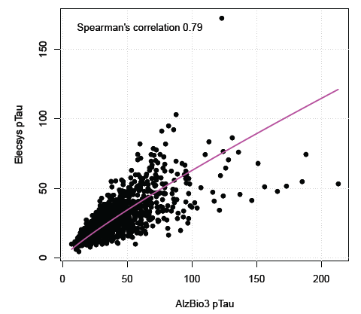
Comparisons between Roche Elecsys & AlzBio3 immunoassays for ADNI1/GO/2 CSFs.
Aβ ₁₋₄₂ t-tau p-tau₁₈₁

Slide 18
ADNI1 BASELINE CSF Aβ₁₋₄₂, t-tau, p-tau₁₈₁& ratios
ADNI1 | Aβ₁₋₄₂ | t-tau | p-tau₁₈₁ | t-tau/Aβ₁₋₄₂ | p-tau₁₈₁/Aβ₁₋₄₂ | % ε4+
 | (pg/mL) | (pg/mL) | (pg/mL)
AD |  |  |  |  |  | 72.6
Median | 548 | 349 | 34 | 0.62 | 0.063
N=95 mean±SD | 610±242 | 359±130 | 36±15 | 0.65±0.28 | 0.066±0.032
95% CI | 305-1125 | 154-687 | 13-73 | 0.15-1.42 | 0.012-0.14
MCI |  |  |  |  |  | 56.6
Median | 633 | 294 | 28 | 0.50 | 0.050
N=176 mean±SD | 741±338 | 312±124 | 31±14 | 0.51±0.30 | 0.052±0.033
95% CI | 292-1624 | 140-599 | 12-63 | 0.12-1.22 | 0.010-0.13
NC |  |  |  |  |  | 26.4
Median | 989 | 218 | 20 | 0.18 | 0.017
N=91 mean±SD | 1018±397 | 239±84 | 22±9 | 0.27±0.18 | 0.026±0.019
95% CI | 394-1640 | 112-444 | 11-43 | 0.11-0.73 | 0.0089-0.079

Slide 19
ADNIGO/2 CSF BASELINE Aβ₁₋₄₂, t-tau, p-tau₁₈₁ & ratios
ADNIGO/2 | Aβ₁₋₄₂ | t-tau | p-tau₁₈₁ | t-tau/Aβ₁₋₄₂ | p-tau₁₈₁/Aβ₁₋₄₂ | % ε4+
 | (pg/mL) | (pg/mL) | (pg/mL)
AD Median | 594 | 334 | 33 | 0.58 | 0.058 | 68.5
N=127 mean±SD | 649±257 | 375±155 | 37±16 | 0.64±0.32 | 0.064±0.034
95% CI | 309-1375 | 170-750 | 15-76 | 0.18-1.42 | 0.014-0.15
LMCI Median | 756 | 286 | 28 | 0.50 | 0.050 | 60.9
N=138 mean±SD | 800±285 | 308±136 | 30±15 | 0.51±0.30 | 0.052±0.033
95% CI | 340-1457 | 115-577 | 10-63 | 0.12-1.22 | 0.010-0.13
EMCI Median | 865 | 234 | 20 | 0.27 | 0.025 | 49.4
N=122 mean±SD | 943±355 | 256±122 | 22±9 | 0.33±0.26 | 0.033±0.029
95% CI | 382-1659 | 117-582 | 11-43 | 0.09-0.95 | 0.0082-0.106
SMC Median | 1111 | 218 | 19 | 0.19 | 0.017 | 43.7
N=71 mean±SD | 1079±374 | 241±94 | 22±10 | 0.25±0.16 | 0.024±0.017
95% CI | 454-1670 | 107-462 | 10-49 | 0.10-0.67 | 0.0084-0.071
NC Median | 974 | 211 | 19 | 0.21 | 0.020 | 33.0
N=109 mean±SD | 1013±379 | 238±92 | 22±9 | 0.27±0.18 | 0.0260.019
95% CI | 342-1686 | 110-469 | 10-48 | 0.09-0.69 | 0.0086-0.073

Slide 20
Aβ₁₋₄₂ all values
1248
1291
1324
1052
658
793*
562
617
Numbers inside the boxes are the respective median values for BL Aβ₁₋₄₂ in pg/mL placed above the median value horizontal line.
*p<0.005 for LMCI ADNIGO+2 vs ADNI1; p=0.11 for NL ADNIGO+2 vs ADNI1; p=0.23 for AD ADNIGO+2 vs ADNI1

Slide 21
t-tau
349
334
294
286
218
211
218
234
Numbers inside the boxes are the respective median values for BL t-tau in pg/mL placed above the median value horizontal line.
P=0.81 for NL ADNIGO+2 vs ADNI1; p=0.51 for MCI ADNIGO+2 vs ADNI1; p=0.81 for AD ADNIGO+2 vs ADNI1

Slide 22
p-tau₁₈₁
34.0
33.2
28.4
27.6
19.9
20.7
19.3
19.3
Numbers inside the boxes are the respective median values for p-tau₁₈₁ in pg/mL placed above the median value horizontal line.
*p=0.71 for ADNIGO+2 vs ADNI1; p=0.43 for MCI ADNIGO+2 vs ADNI1; p=0.88 for AD ADNIGO+2 vs ADNI1.

Slide 23
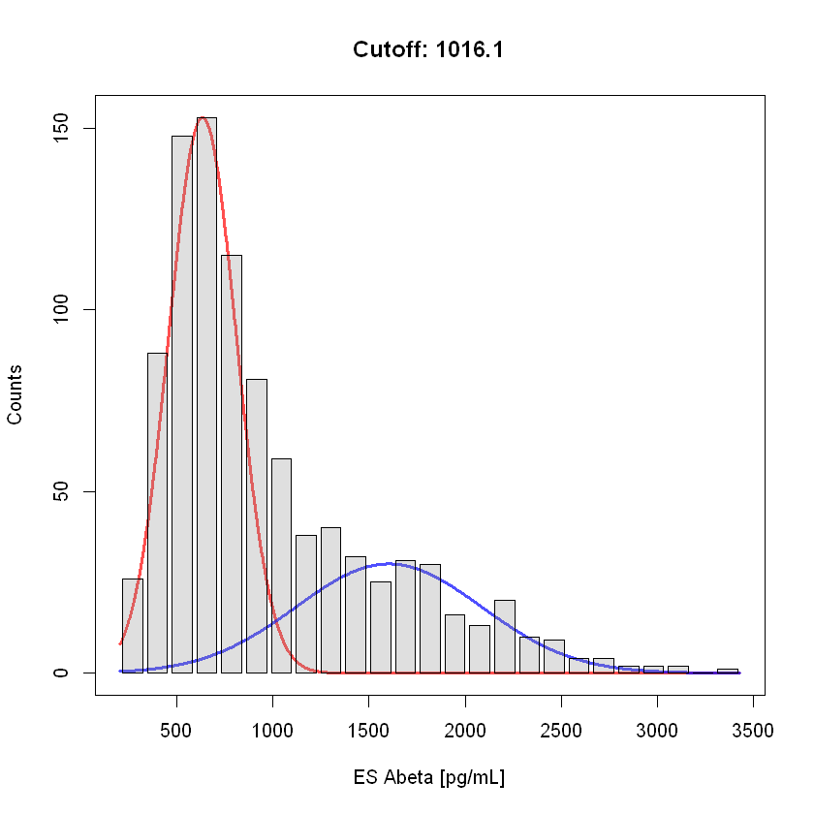
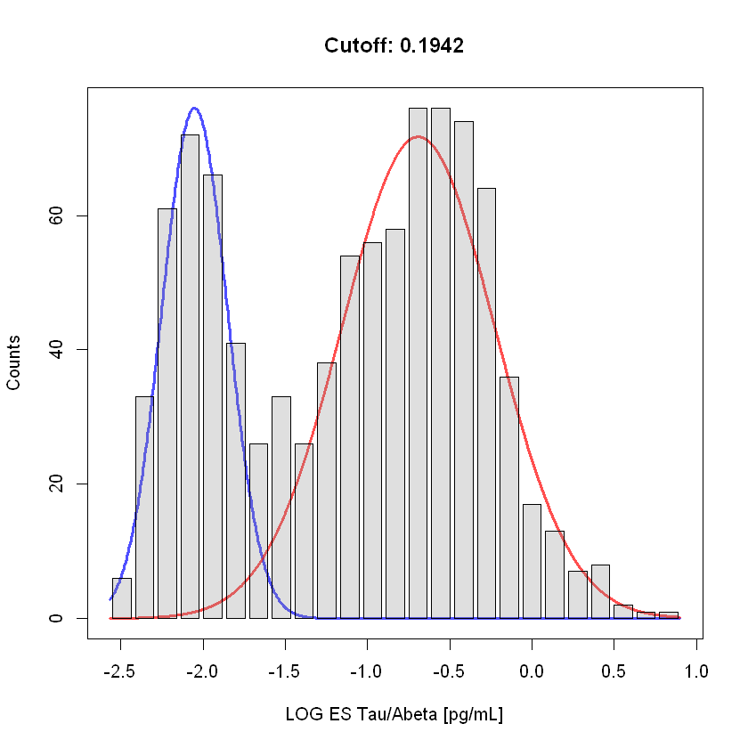
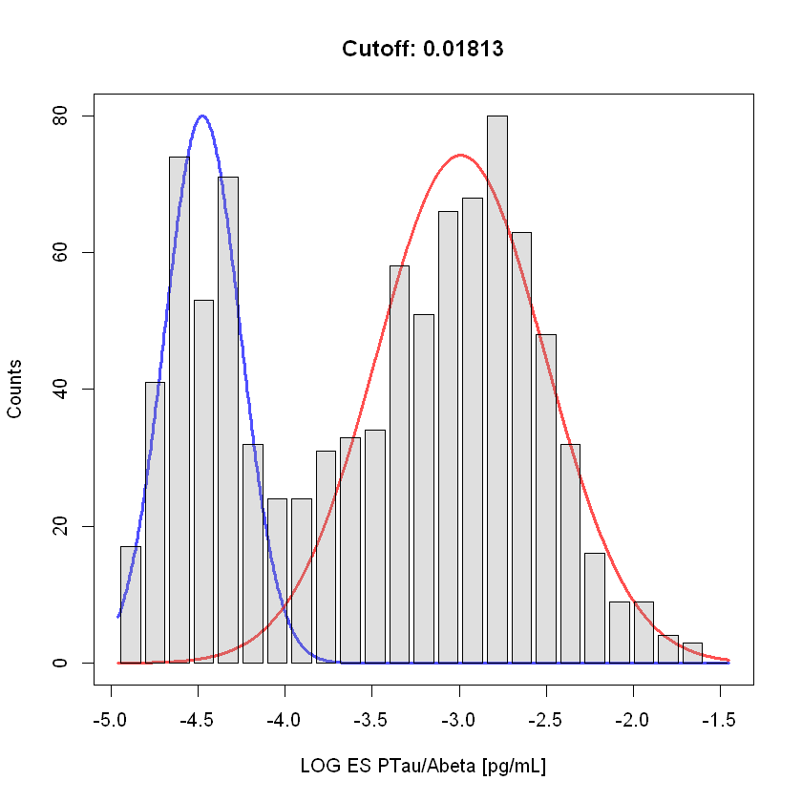
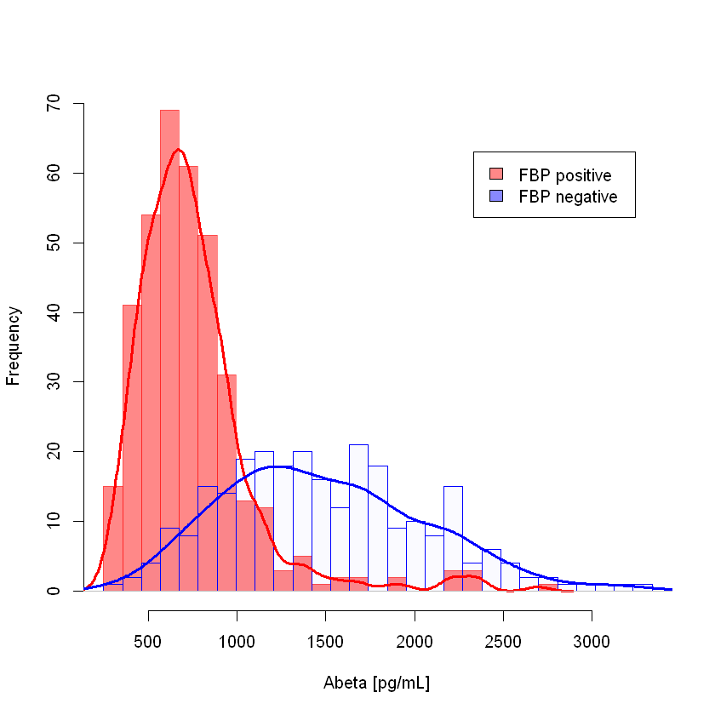
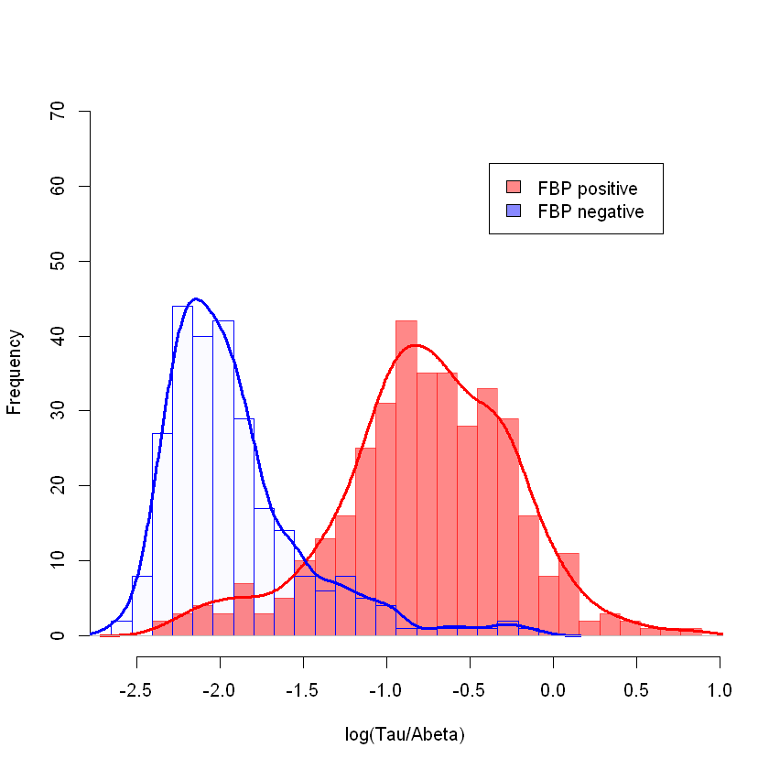
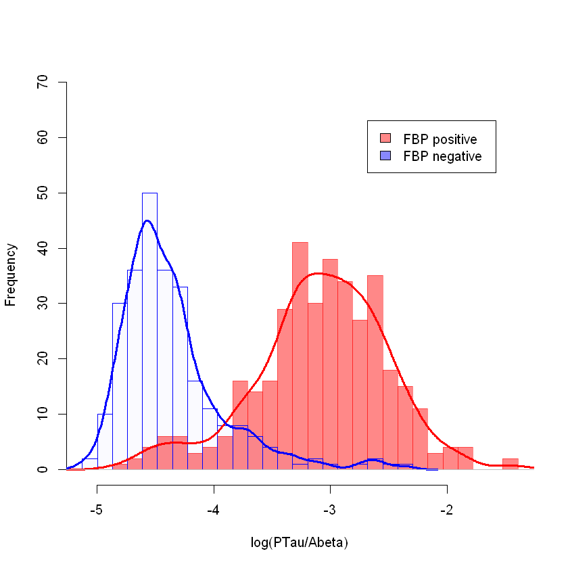
Frequency distribution plots: upper are mixture model plots, lower are FBP+ and FBP- for ADNI SMC/EMCI/LMCI/AD
Aβ₁₋₄₂
tau/Aβ₁₋₄₂
ptau₁₈₁/Aβ₁₋₄₂

Slide 24
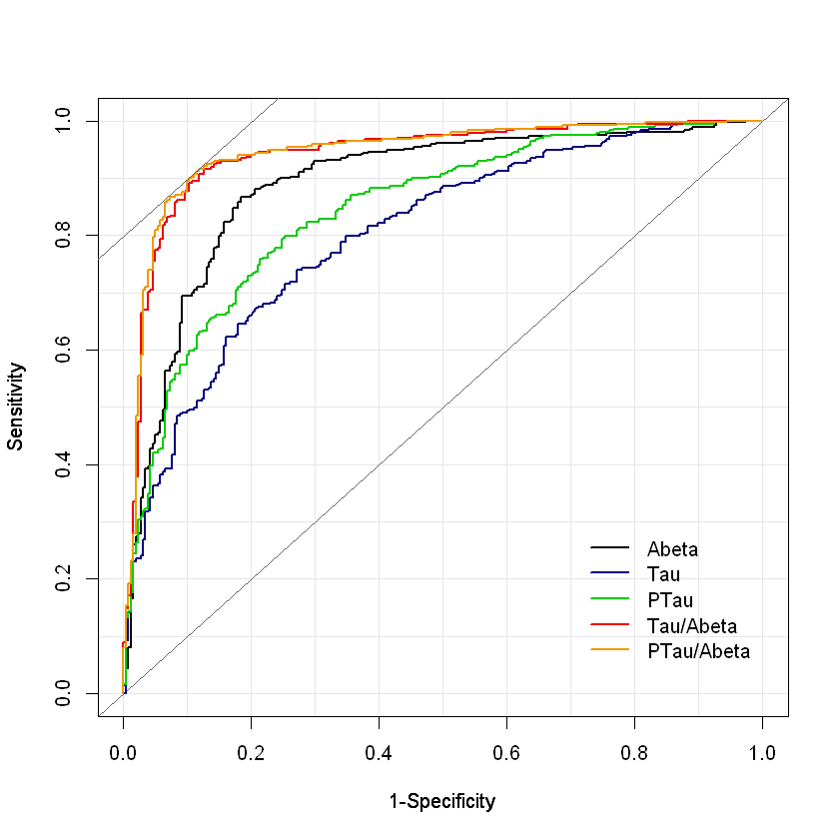
ROC Curves for SMC+EMCI+LMCI+AD CSF biomarkers using FBP PET+/- as the clinical endpoint*
AUC values: Sens Spec Eff
p-tau/Aβ₁₋₄₂ 0.944 91.3% 88.5% 90.2%
t-tau/Aβ₁₋₄₂ 0.940 91.6% 87.4% 89.9%
Aβ₁₋₄₂ 0.889 86.7% 81.7% 84.6%
p-tau₁₈₁ 0.845 79.9% 74.8% 77.8%
t-tau 0.803 74.0% 72.9% 73.5%
Cutpoint values:
p-tau/Aβ₁₋₄₂ 0.021
t-tau/Aβ₁₋₄₂ 0.222
Aβ₁₋₄₂ 980 pg/mL
p-tau₁₈₁ 21.8 pg/mL
t-tau 245 pg/mL
*SUVR of 1.1 used: Landau and Jagust

Slide 25
Cutpoint assessments for CSF Aβ₁₋₄₂, t-tau & p-tau₁₈₁ in ADNI
ROC with FBP PET as the endpoint:
  Aβ₁₋₄₂, 980 pg/mL t-tau/Aβ₁₋₄₂, 0.22
  t-tau, 245 pg/mL p-tau₁₈₁/Aβ₁₋₄₂, 0.021
  p-tau₁₈₁, 21.8 pg/mL
Disease-independent mixture modeling
  Aβ₁₋₄₂, 1016 pg/mL t-tau/Aβ₁₋₄₂, 0.19
  t-tau, NA p-tau₁₈₁/Aβ₁₋₄₂, 0.018
  p-tau₁₈₁, NA
Prediction from BioFINDER study based on pre-analytic differences
  Aβ₁₋₄₂, 880 pg/mL t-tau/Aβ₁₋₄₂, 0.33
  t-tau, 270 pg/mL p-tau₁₈₁/Aβ₁₋₄₂, 0.028
  p-tau₁₈₁, 24 pg/mL

Slide 26
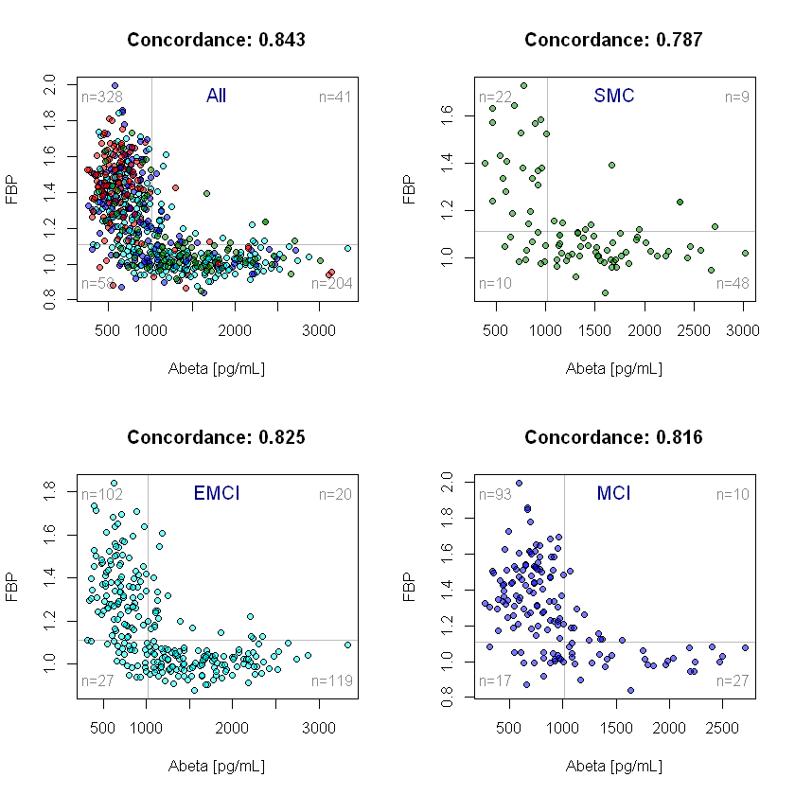
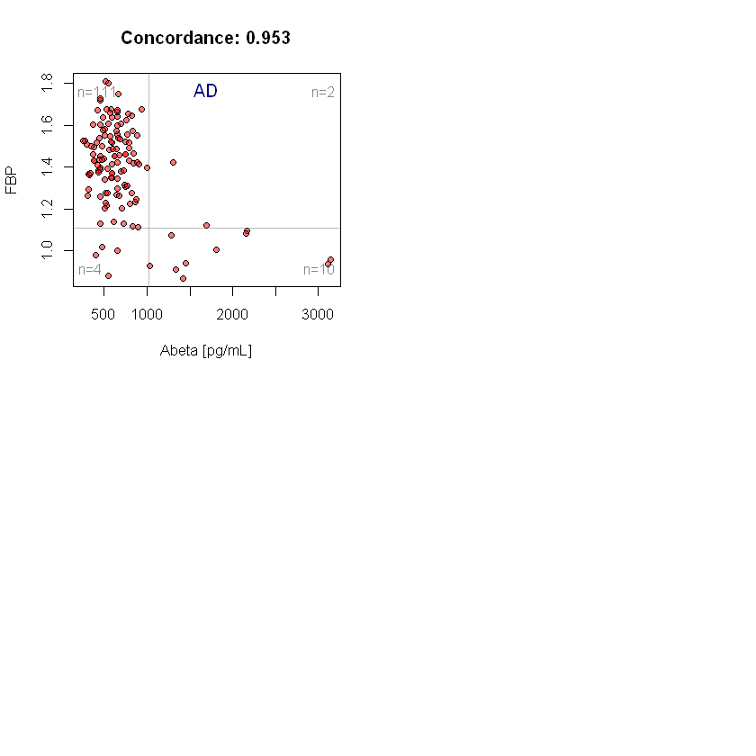
Concordance plots for FBP vs CSF Aβ₁₋₄₂ in ADNIGO/2 SMC, EMCI, LMCI & AD participants at BASELINE

Slide 27
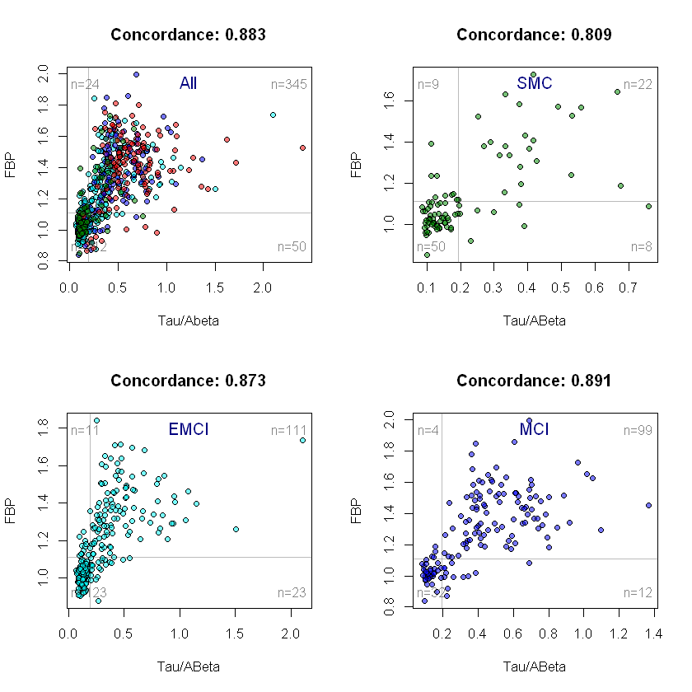
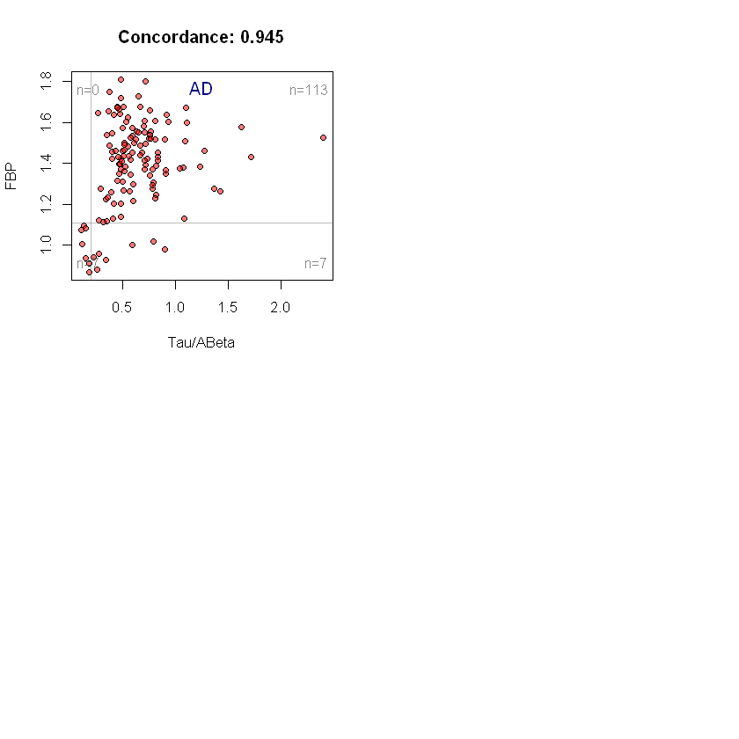
Concordance plots for FBP vs CSF tau/Aβ₁₋₄₂ in ADNIGO/2 SMC, EMCI, LMCI & AD
participants at BASELINE

Slide 28
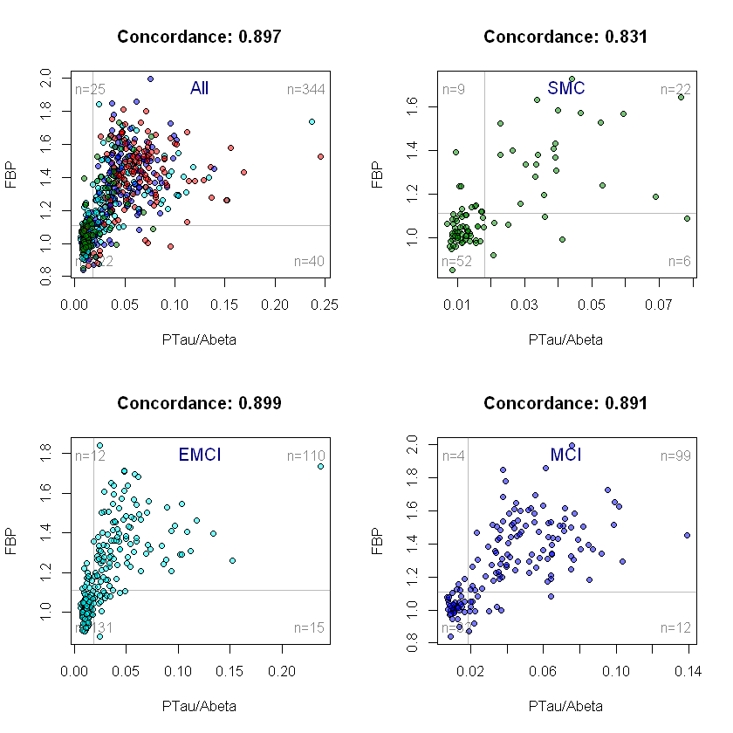

Concordance plots for FBP vs CSF ptau/Aβ₁₋₄₂ in ADNIGO/2 participants at BASELINE

Slide 29
Prediction of cognitive decline(CDRsob) in ADNIGO/2 LMCI subjects
Aβ₁₋₄₂
t-tau/Aβ₁₋₄₂
riskTAA2i
Vertical red arrow points to regression line for CDRsob values associated with Aβ₁₋₄₂ values below cutpoint value,
t-tau/Aβ₁₋₄₂ values above cutpoint value, and logistic regression model(includes Aβ₁₋₄₂, t-tau and APOE ε4 allele #
as covariates) values above cutpoint value.

Slide 30
Summary
Roche Elecsys immunoassays for Abeta1-42, t-tau and p-tau181 completed for 2401 ADNI1/GO/2 CSFs, and uploaded on the ADNI/LONI website, March 2017
Precision and accuracy validations completed according to CLSI EP05
General stats, Frequency distributions, mixture modeling & ROC with FBP PET as endpt described
The t-tau/Aβ₁₋₄₂ and p-tau₁₈₁/Aβ₁₋₄₂ ratios outperformed Aβ₁₋₄₂ alone for clinical utilities based on:
  Comparisons to FBP PET in ROC analyses
  Concordance with FBP PET
  Disease-independent mixture modeling
  This observation is consistent with the BioFINDER study(using Roche platform/flutemetmol PET) as well as multiple other studies that used other immunoassay platforms and clinical endpoints:
    Seeburger, 2015(OPTIMA study, N=227, autopsy-based diagnosis); Fagan, 2011(HASD, PIB PET based endpoint, N=103); Palmqvist, 2015(BioFINDER, Flutemetamol PET, N=366)
  Mechanism possibilities: normalization of variance; tau abnormality adds to predictive performance, further studies needed
Cutpoint assessments: ROC with FBP as endpoint; disease independent mixture modeling; extrapolation from BioFINDER study based on pre-analytical differences
Prediction performance of BASELINE CSF AD biomarkers for cognitive decline documentation
Continue ongoing work with ADNI and other studies toward goal of defining universal cutpoints for Aβ₁₋₄₂, t-tau and p-tau₁₈₁.
Continue to work with colleagues on pre-analytical and other factors to help minimize and control these sources of variability
Implement in ADNI3
Collaboration on multimodal studies that include CSF, imaging, genetic, clinical parameters

Slide 31
ACKNOWLEDGEMENTS
Biomarker Research Lab
Magdalena Korecka
Michal Figurski
Magdalena Brylska
Teresa Waligorska
Leona Fields
Jacob Alexander
Ju Hee Kang
CNDR/ADRC
John Trojanowski
Virginia M-Y Lee
Steve Arnold
Murray Grossman
Jon Toledo
Alice Chen-Plotkin
*Deceased
William Hu
Anne Fagan
Hugo Vanderstichele
Kaj Blennow
Henrik Zetterberg
Chris Clark*
Manu Vandijck
John Lawson
Udo Eichenlaub
Tobias Bittner
The Roche team
*Deceased
Robert Dean
Holly Soares
Adam Simon
Eric Siemers
Piotr Lewczuk
William Potter
Rand Jenkins
Erin Chambers
Supported by the NIH/NIA & families
of our patients
MJ Fox Fdn for PD research
ADNI investigators include: (complete listing available at www.loni.usc.edu\ADNI\ Collaboration\ADNI_Manuscript_Citations.pdf

